Slide 2

Nam Phong Primary School
WELCOME TO CLASS
3B
Teacher: Nguyen Thi Tuyet Lan

Slide 3



LET’S SING A SONG

Slide 4


Slide 6

Let’s play game
Who’s missing?

Slide 8
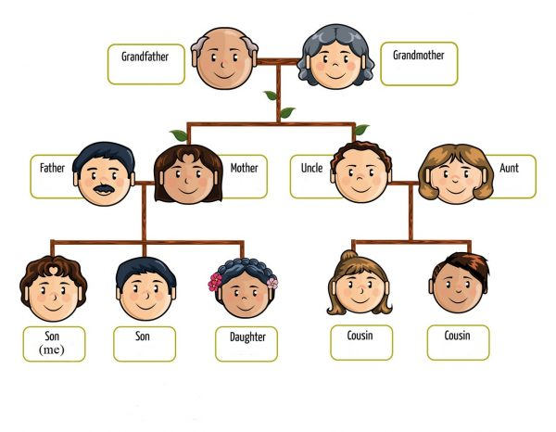
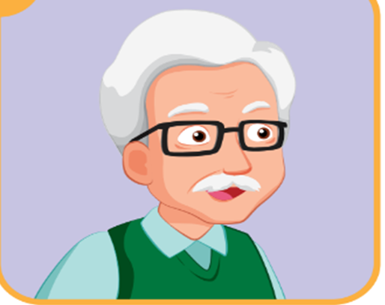
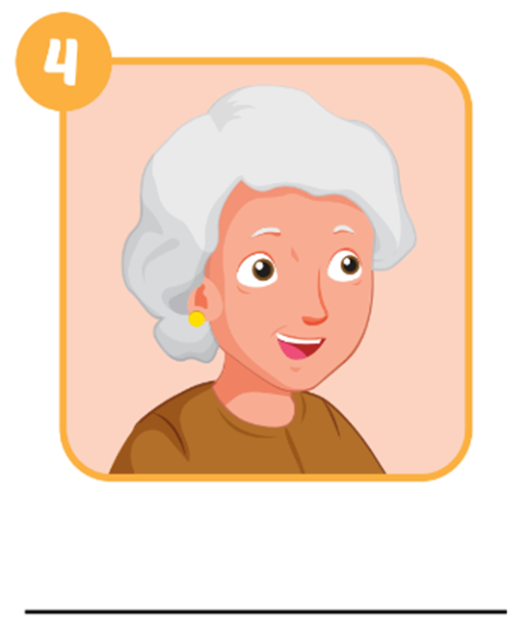


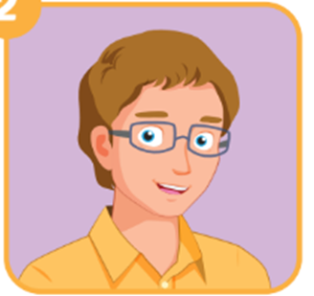
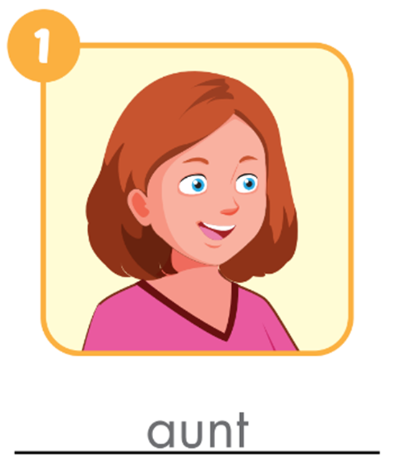
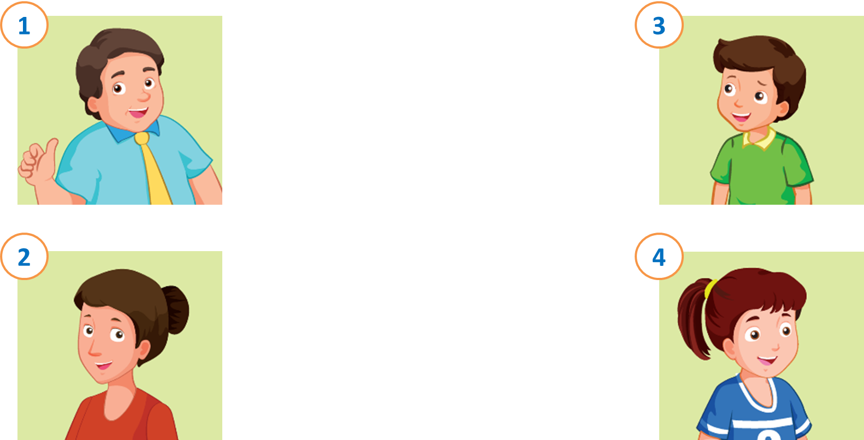
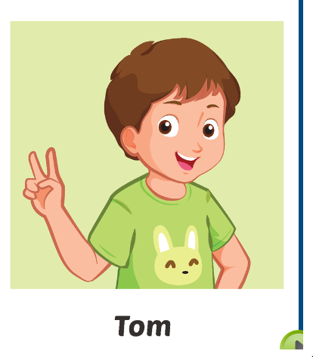

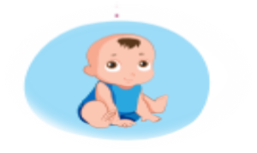


Tom’s family
Dan
Grace
Sam
Ann
Tony
May
sister
brother
brother
cousin
cousin
Lucy
Tom
Ben
Alex
Sue
Bill

Slide 9


Tom’s family
grandfather
grandmother
grandmother
father
mother
uncle
aunt
sister
Tom
brother
brother
cousin
cousin

Slide 12

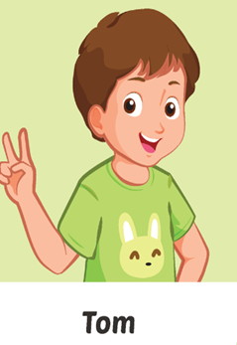
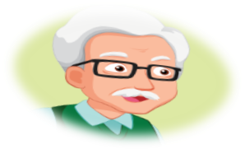

E.Point,ask,and answer
Who’s.....?
He’s my grandfather
he
His name’s Dan
his
What’s ..... name?

Slide 13
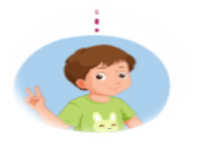


E.Point, ask,and answer
Who’s.......?
She’s my grandmother
she
Her name’s Grace
her
What’s ..... name?

Slide 15
Tom’s family
grandfather
grandmother
grandmother
father
mother
uncle
aunt
sister
Tom
brother
brother
cousin
cousin

Slide 17

Work in groups

Slide 18
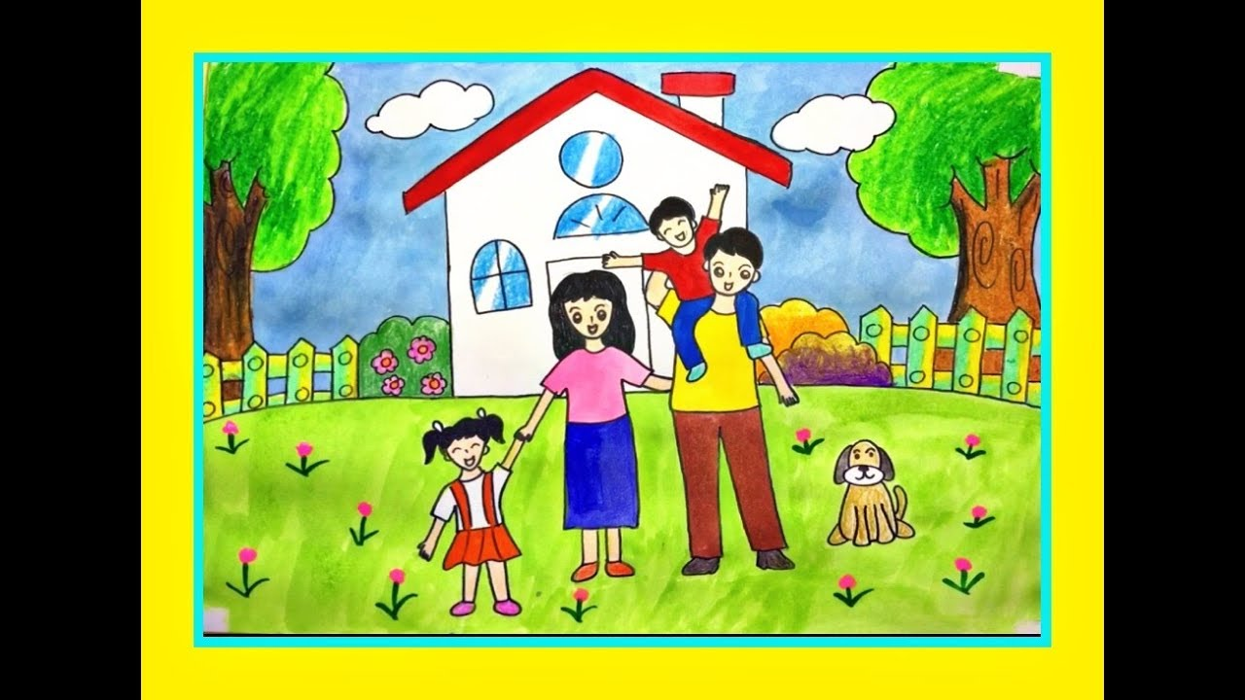
F. Draw your family. Ask and answer

Slide 19

It’s time to work in groups

Slide 20
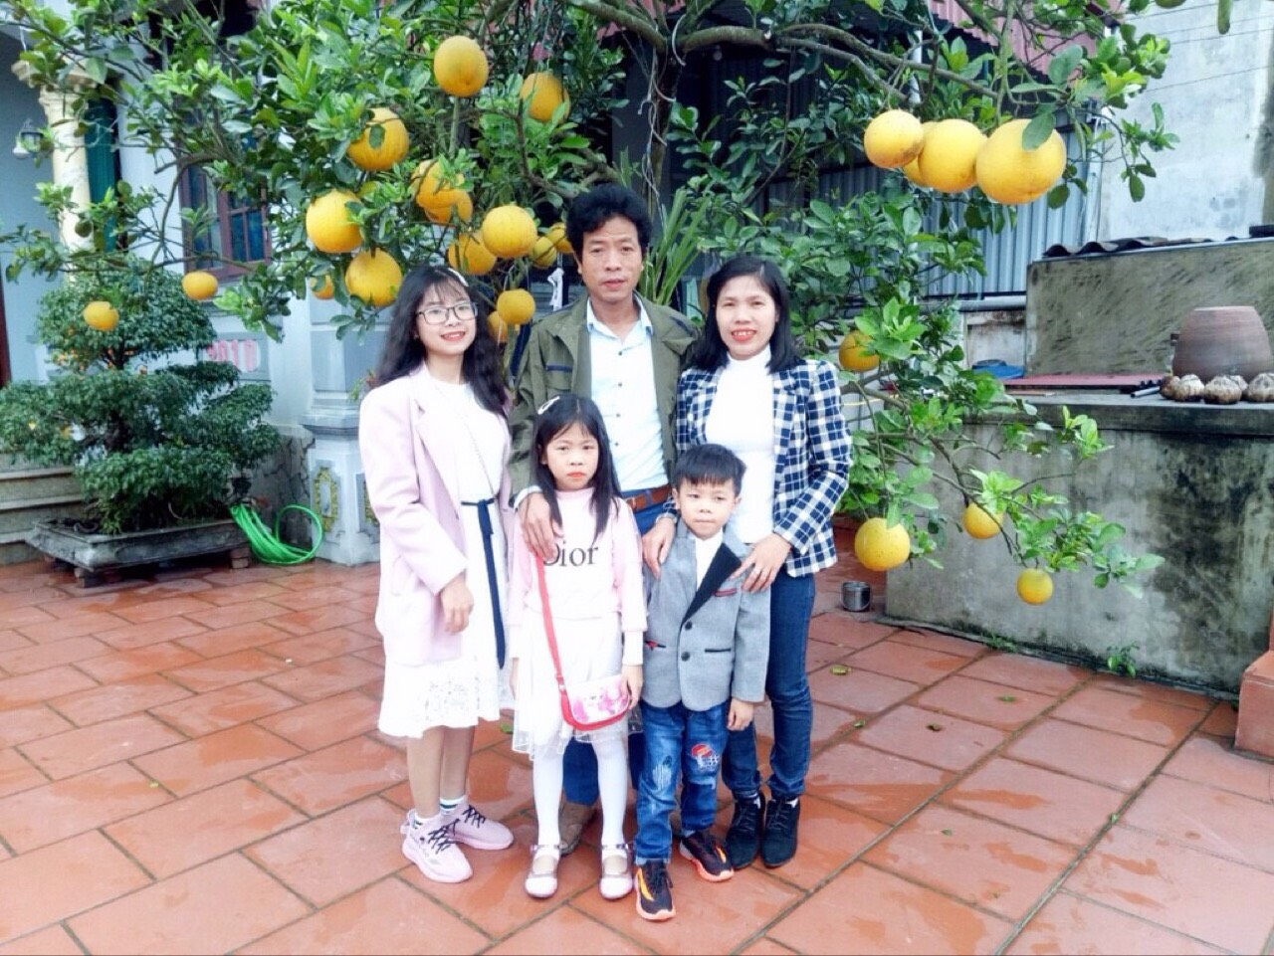

Slide 21
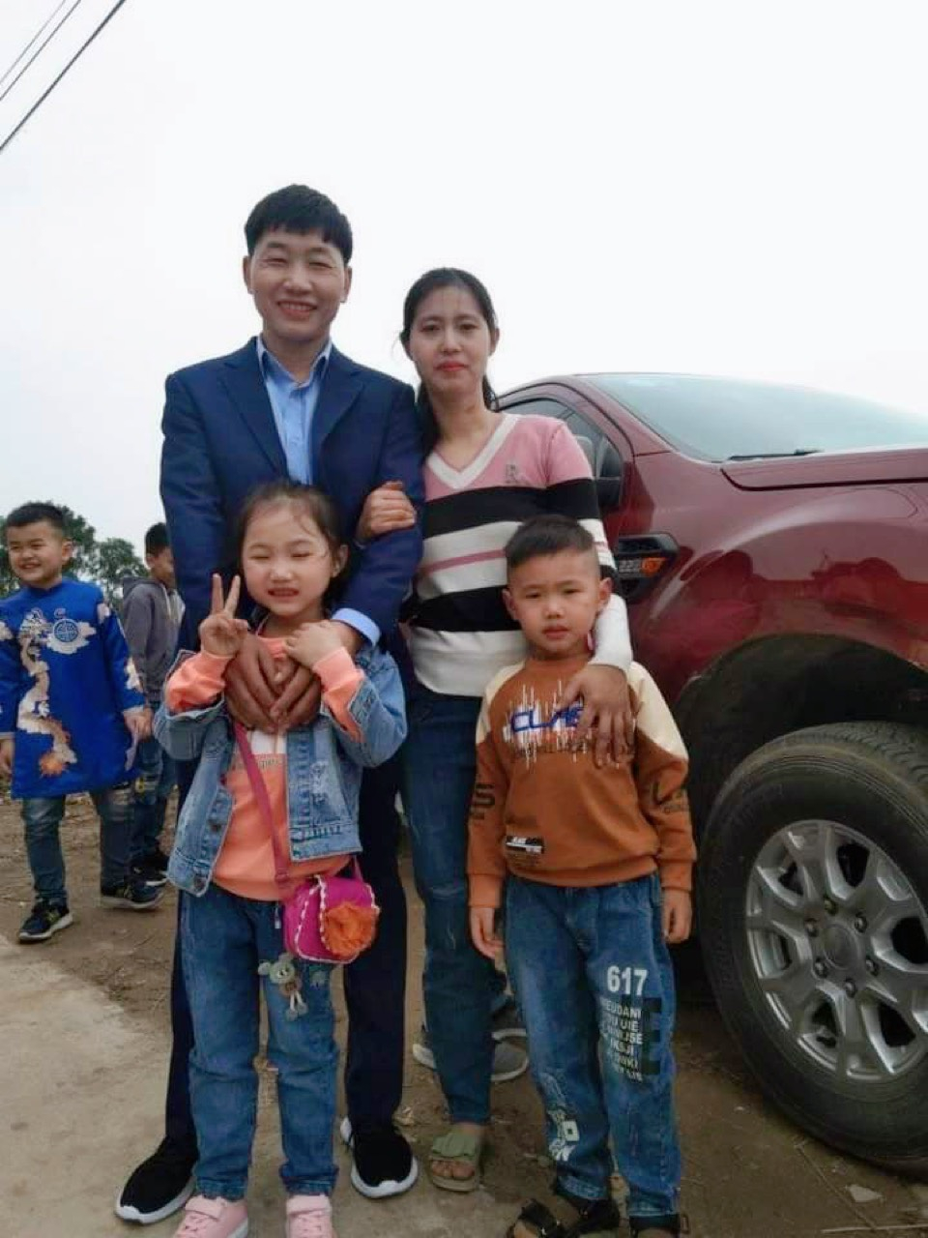

Slide 22
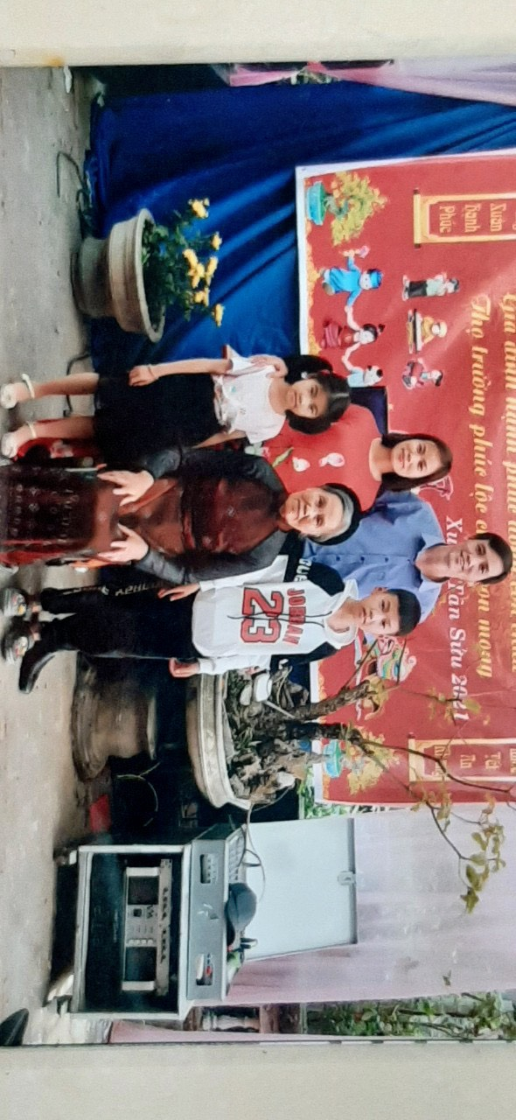

Slide 23
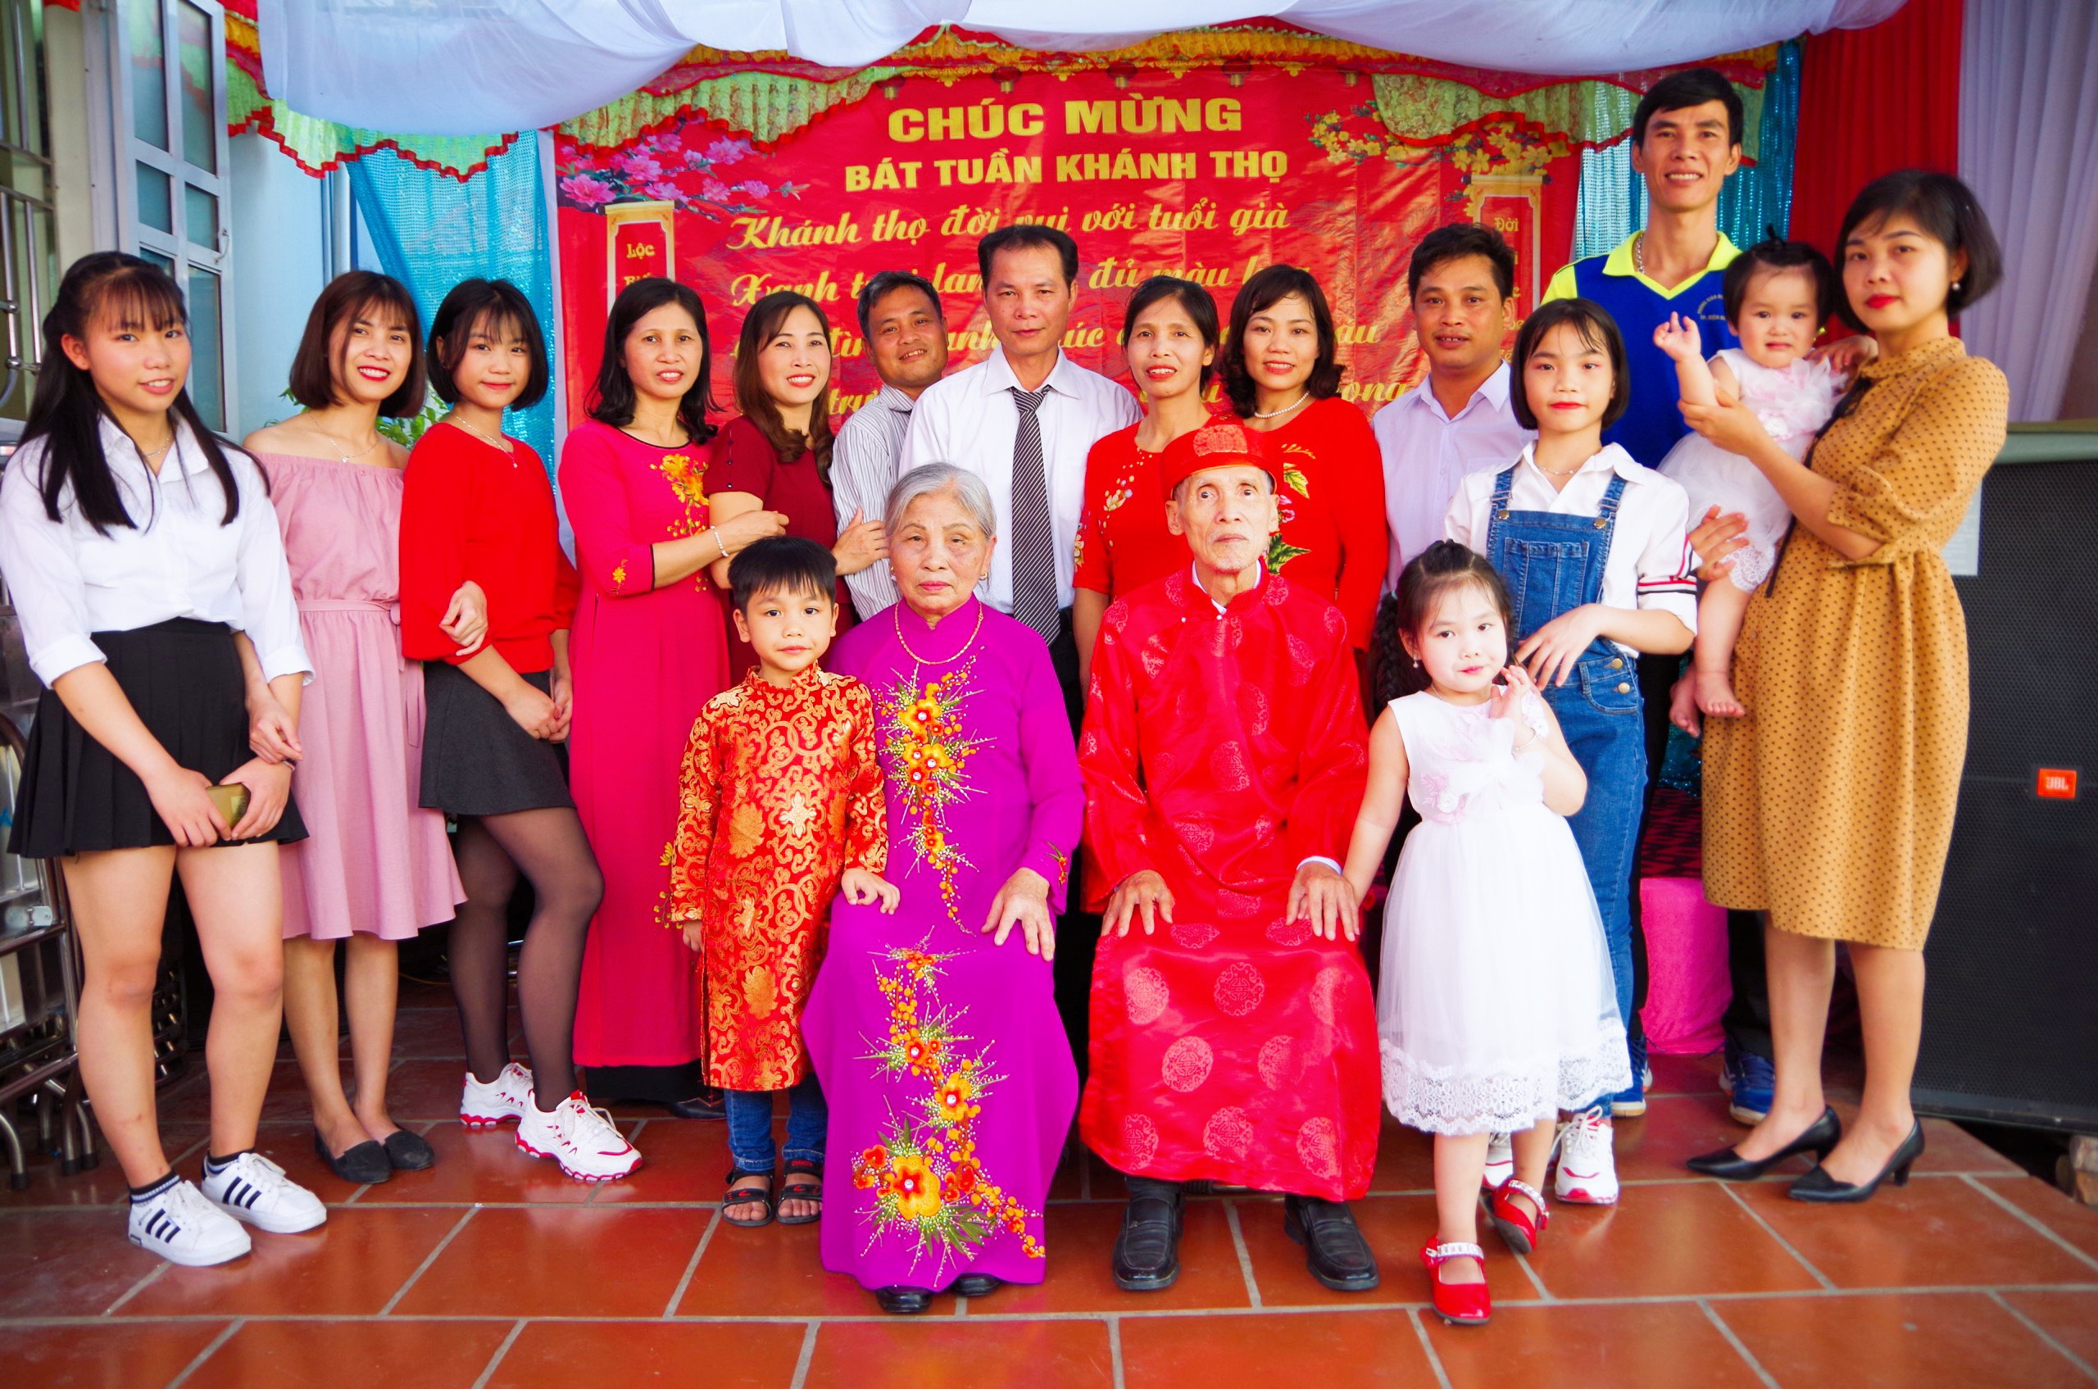

Slide 24
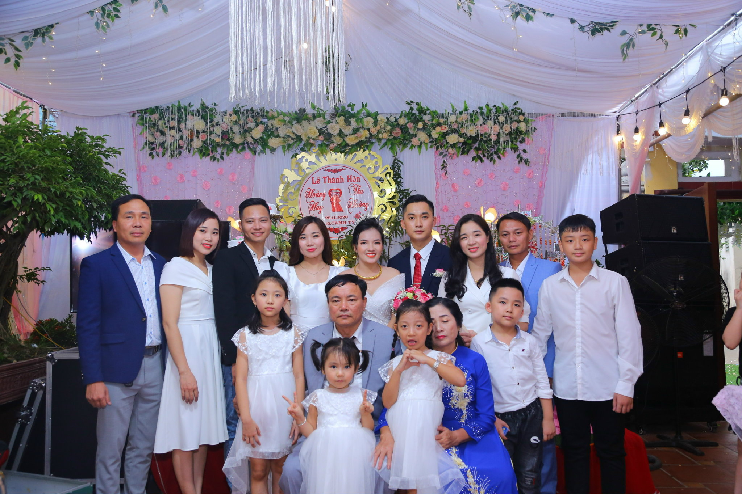

Slide 26



V. Homework:
- Tell about your family using the structure in Lesson 1,2 and do exercise in workbook page 20,21
- Prepare the next lesson in page 30.

Slide 27
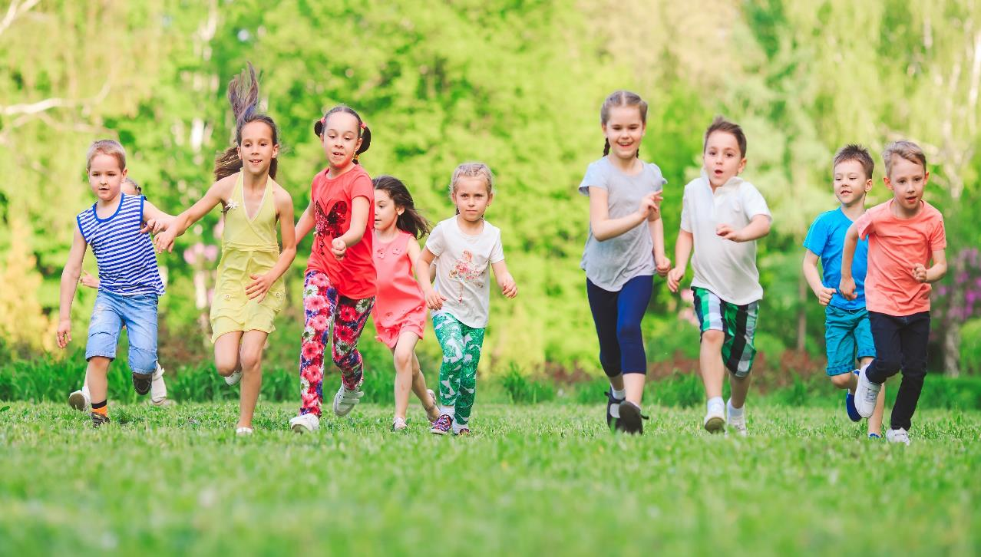
Have a nice day

